Slide 1



Smart Virtual Assistant

Slide 2
MEET THE TEAM
Gajbhare Chandramani
Bhartani Rohit
Tarange Swamini
Kale Rutuja
Londhe Ankita
Patil Ashvini

Slide 3

INTRODUCTION
The basic idea behind this project is to create a simple stand-alone application that helps less tech savvy people in the world to use the computer without feeling ignorant or computer illiterate. Computers have become a very important devices and as well as less expensive over time.
The application works same like Siri/ Google Assistant etc. But the application deals with the computer itself mainly.
In this Project physically disable person or the person having less knowledge about smart phone or how to access the smart phone can easily access the phone with their voice or speech command. This application includes the functions and services such as: calling services, text message transformation, mail exchange, alarm, event handler, location services, music player service, checking weather, Google search, Wikipedia search, camera, Bluetooth headset support and help menu.
The main motive behind this software is to help end-user and make it work faster and efficient. S/w access all our system and provides output as per the request given by user.

Slide 4
ABSTRACT
Smart Virtual Assistant (SVA) is the next generation of carrier services.
SVA is believed to be the intelligent evolution of services to meet the ever increasing demand by the professionals for desktop and connectivity.
This new generation of services will allow desktop users to remotely access and manage information using speech recognition technology over internet.
The SVA enables the user to optimize the user resources (time, cost), enhance his/her overall productivity, and minimize the interruptions to his regular workflow.
The Smart Virtual Assistant (SVA) will enable the user to efficiently handle increasing demand of sending emails, messages, bot-chat and other activities.

Slide 5
Project Scope
The project has a very vast scope in future. The project can be implemented on intranet in future. Project can be updated in near future as and when requirement for the same arises, as it is very flexible in terms of expansion. With the proposed software of database Space Manager ready and fully functional the client is now able to manage and hence run the entire work in a much better,
accurate and error free manner. The following are the future scope for the project.
Alexa.
Crotona.
Siri

Slide 6

Goal and Objective
◆ Requesting information.  Similarly to inputting a search query.  Playing music.  Performing mathematical calculation.  Sending mails. The goal of proposed is to improve performance and accuracy of are as follows:  To solve all problems in current system.  To fulfill the requirement of user and make the process faster and efficient  To generate efficient Output based on voice input.

Slide 7
FEATURES
◆ Opening and Closing of an Application.  Displaying system information such as network usage, ram etc.  It provides an easy interface to user.  Creating a new window or a tab in browser  Sending mails, performing Calculations, Chatbot.

Slide 8
Specification
Hardware Specification :  Memory Space : 100MB  RAM : 512 MB Minimum & 2GB Maximum  Processor : Recommended 1.5GHz or better Software Specification :  Application Libraries : Python and Web  Language : Python  Tools : Pycharm, Google API, Amazon API  Operating System : Windows 7 or above

Slide 9
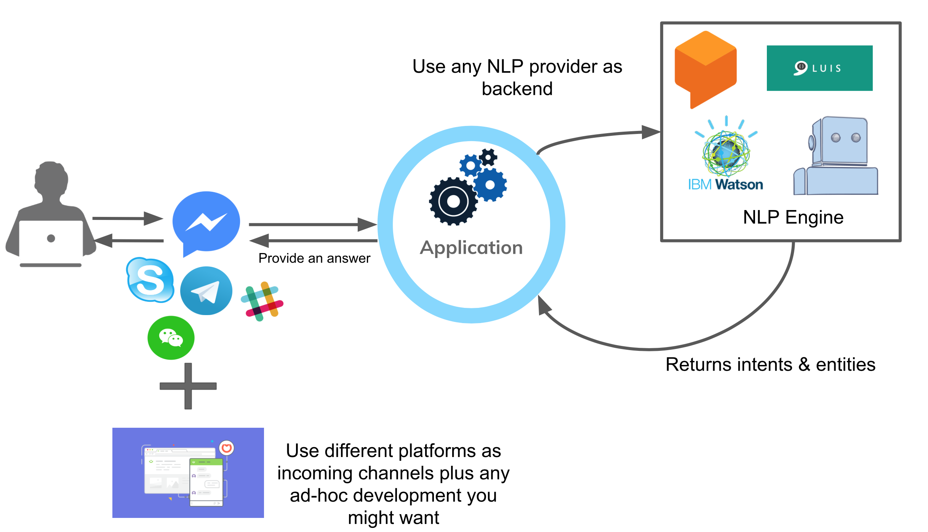
SYSTEM ARCHITECTURE

Slide 10
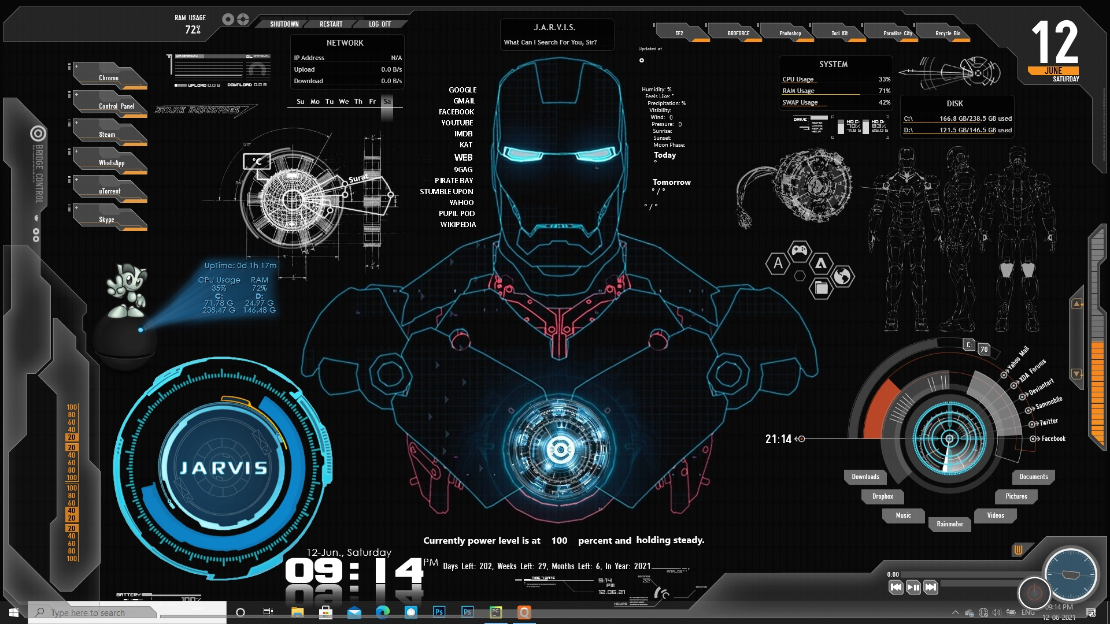
OUTPUT

Slide 11



